Slide 1
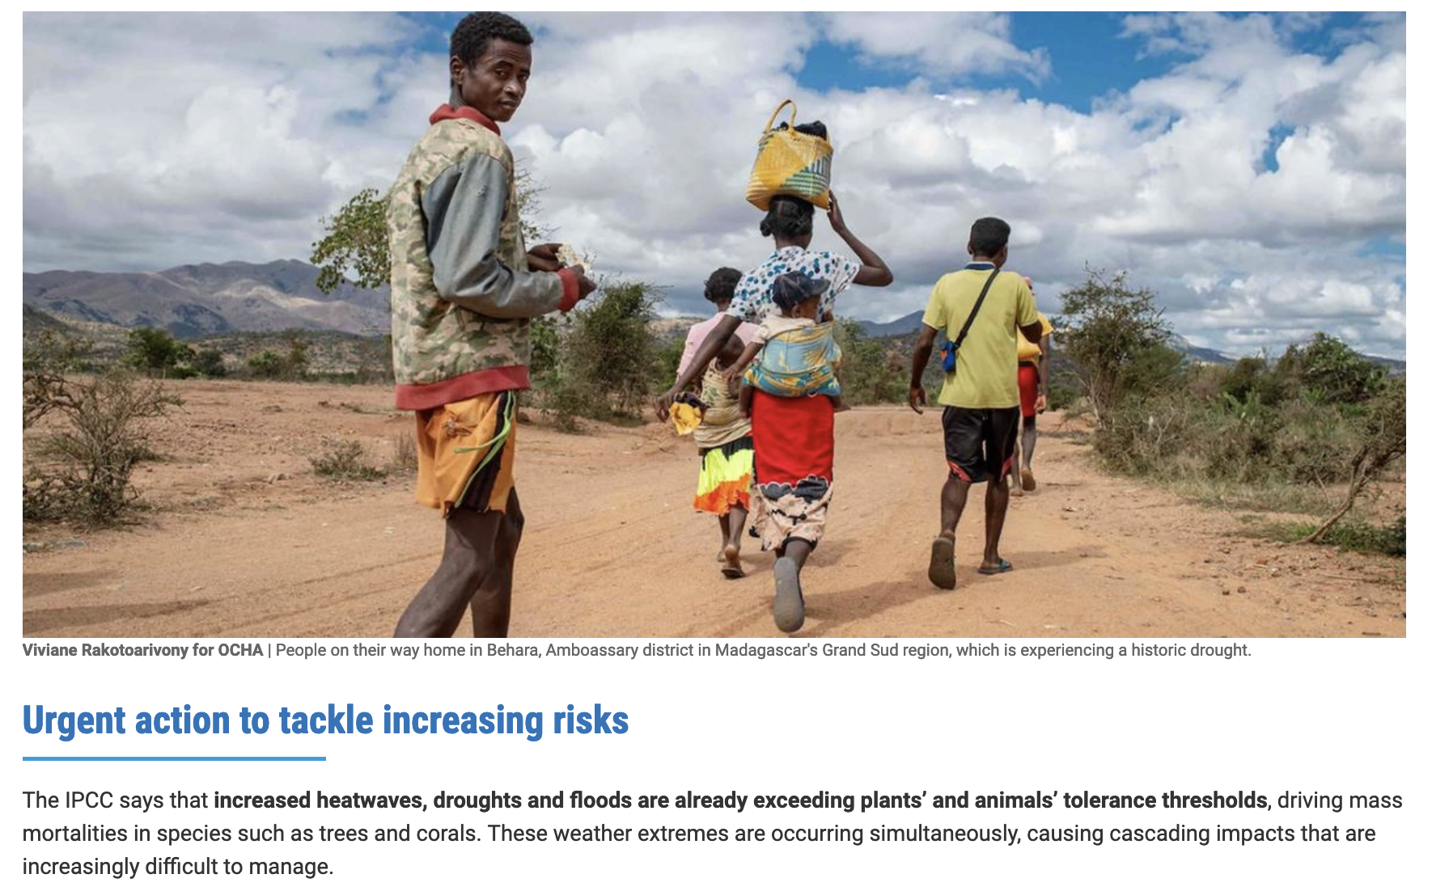
Do we have solid evidence of change? Of tipping-point change? IPCC, UN …

Slide 2
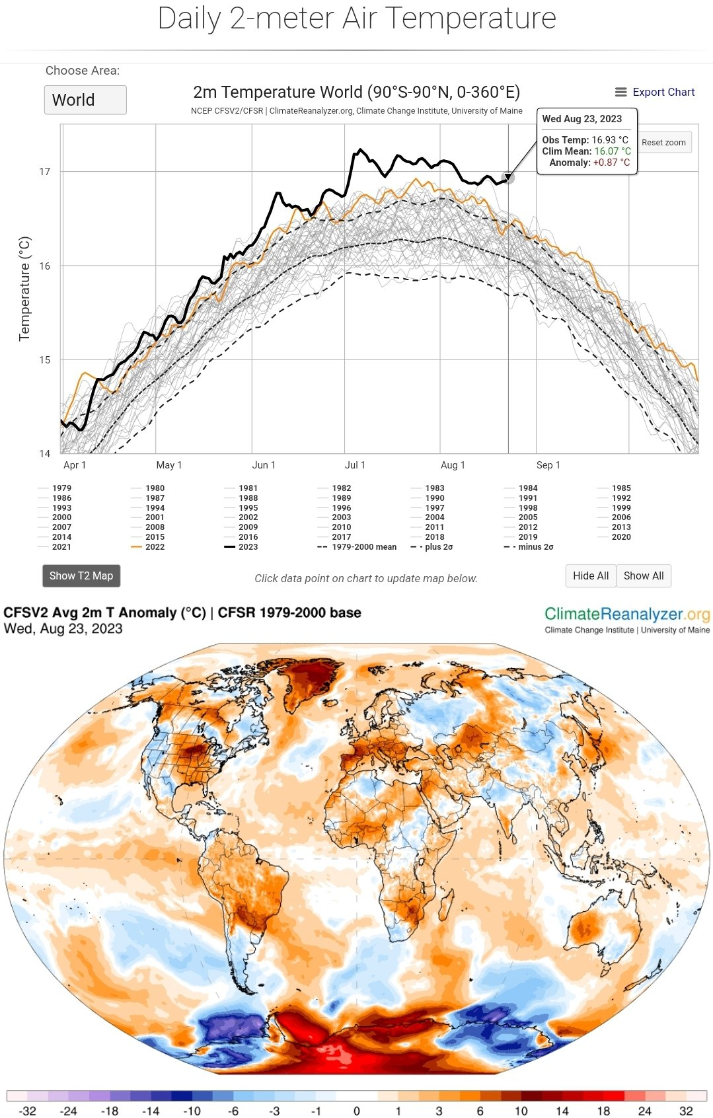
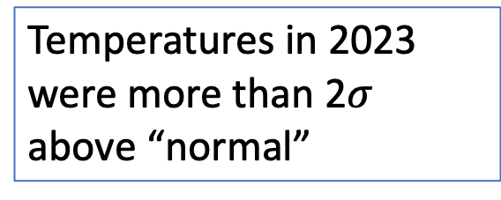
A key driving factor in tipping points is the global increase in surface air temperature
Temperatures in 2023 were more than 2$σ$ above “normal”
The poles are getting especially hammered

Slide 3
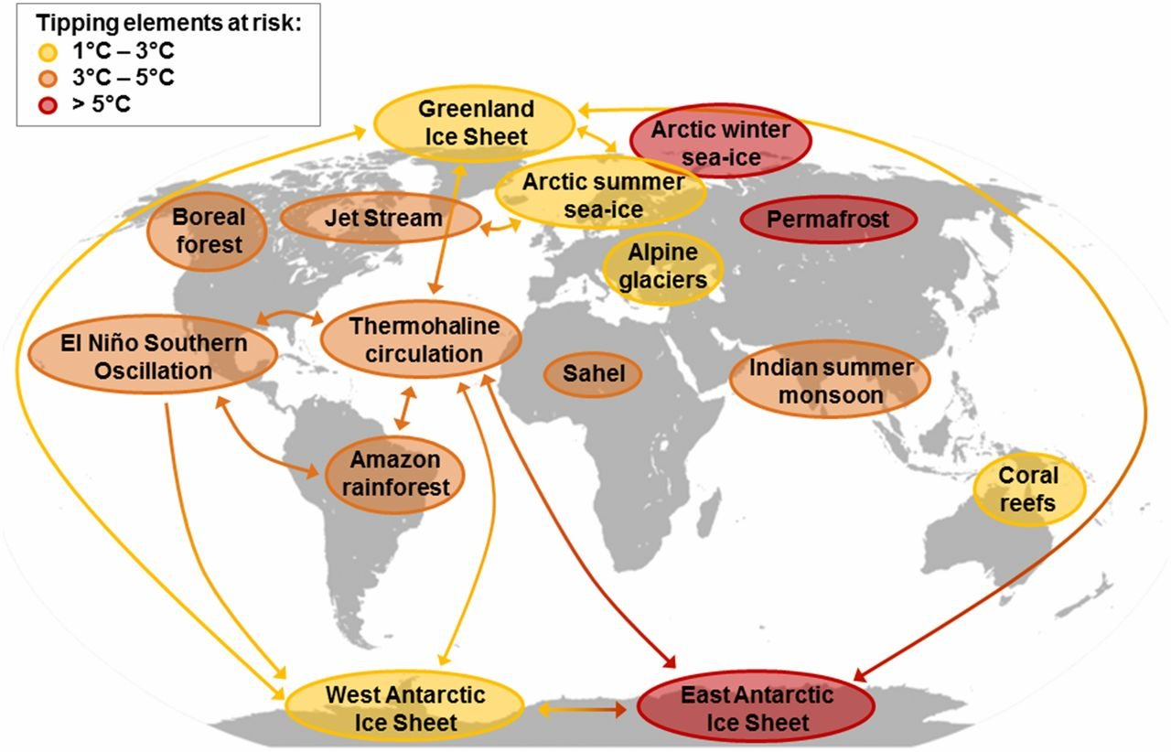
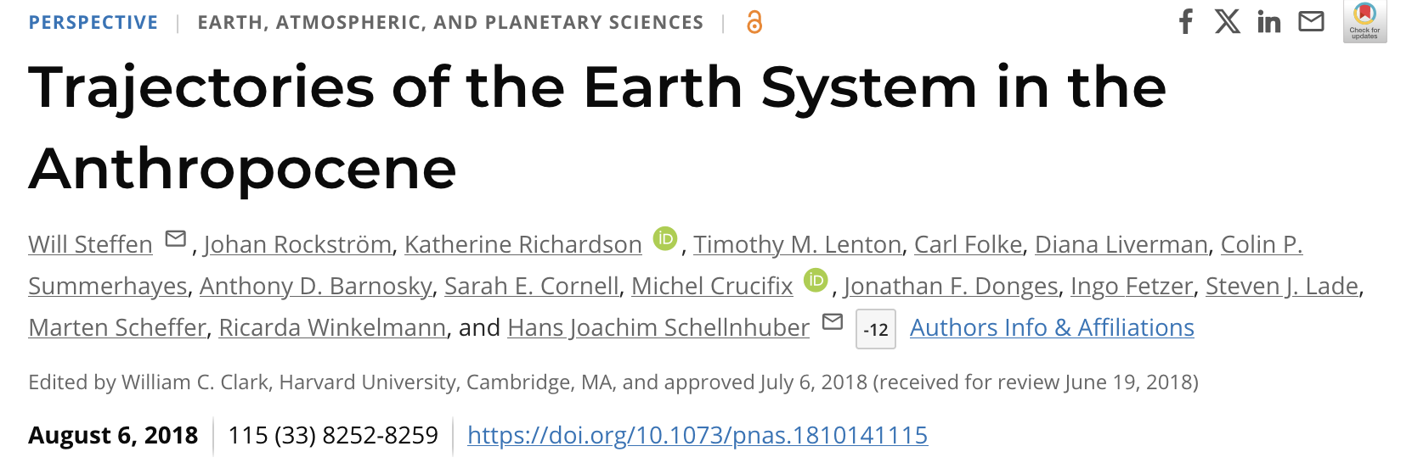
Tipping points vs tipping elements

Slide 4
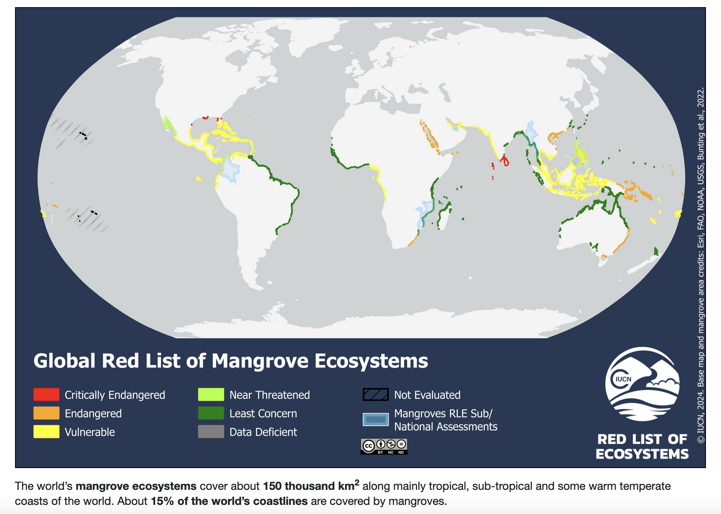
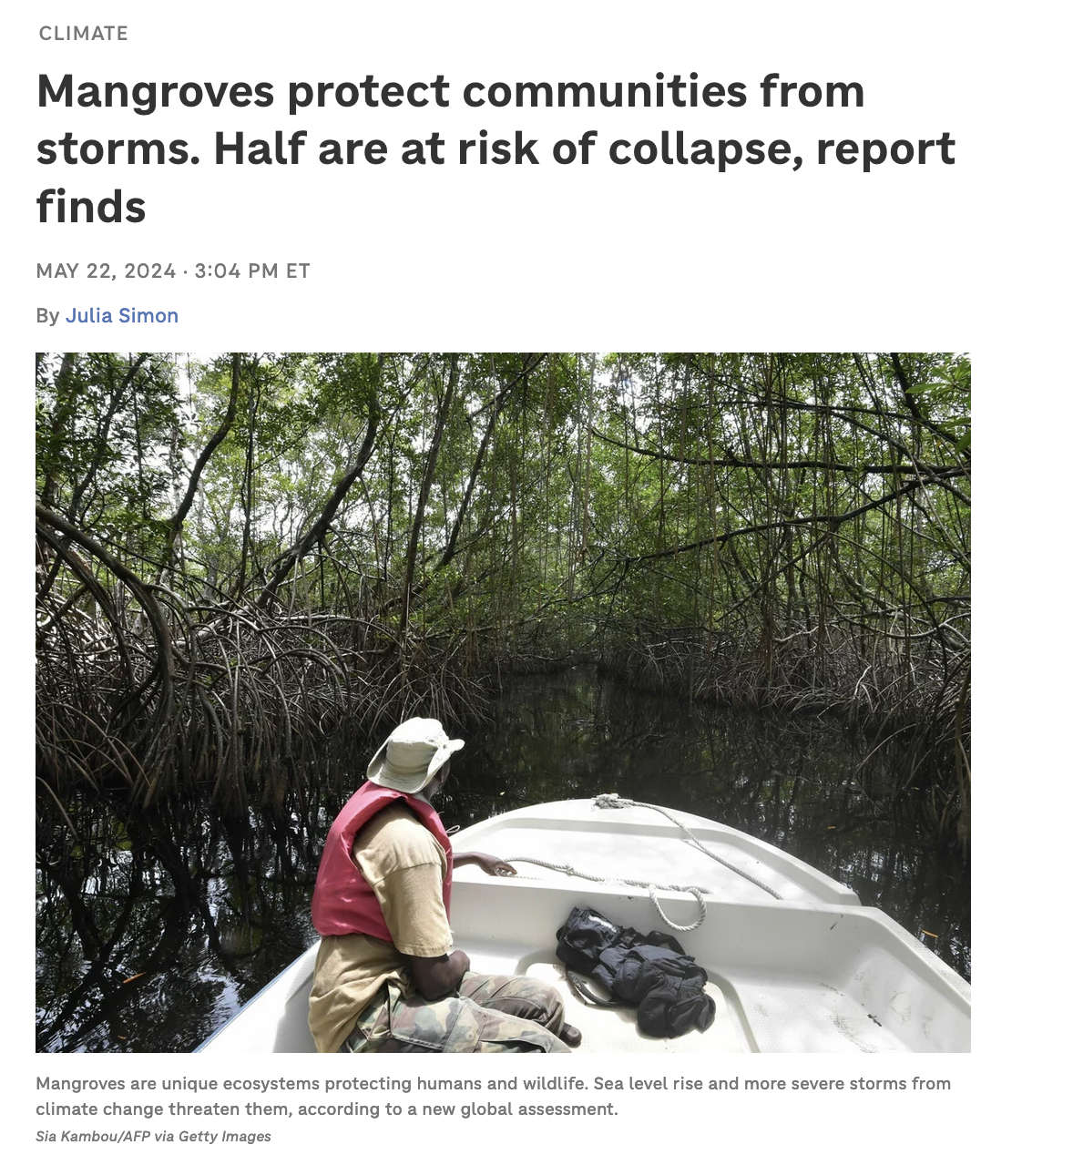
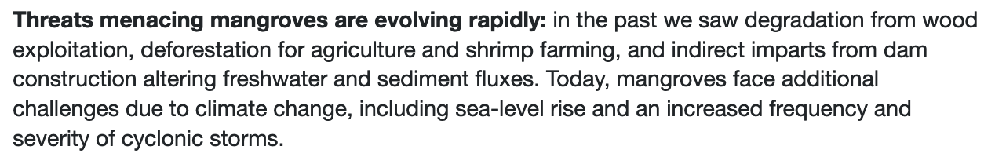
Mangrove ecosystems are “critically endangered” because of increased frequency and severity of cyclonic storms (which are due to ocean warming)

Slide 5
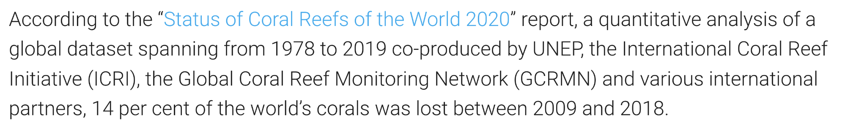
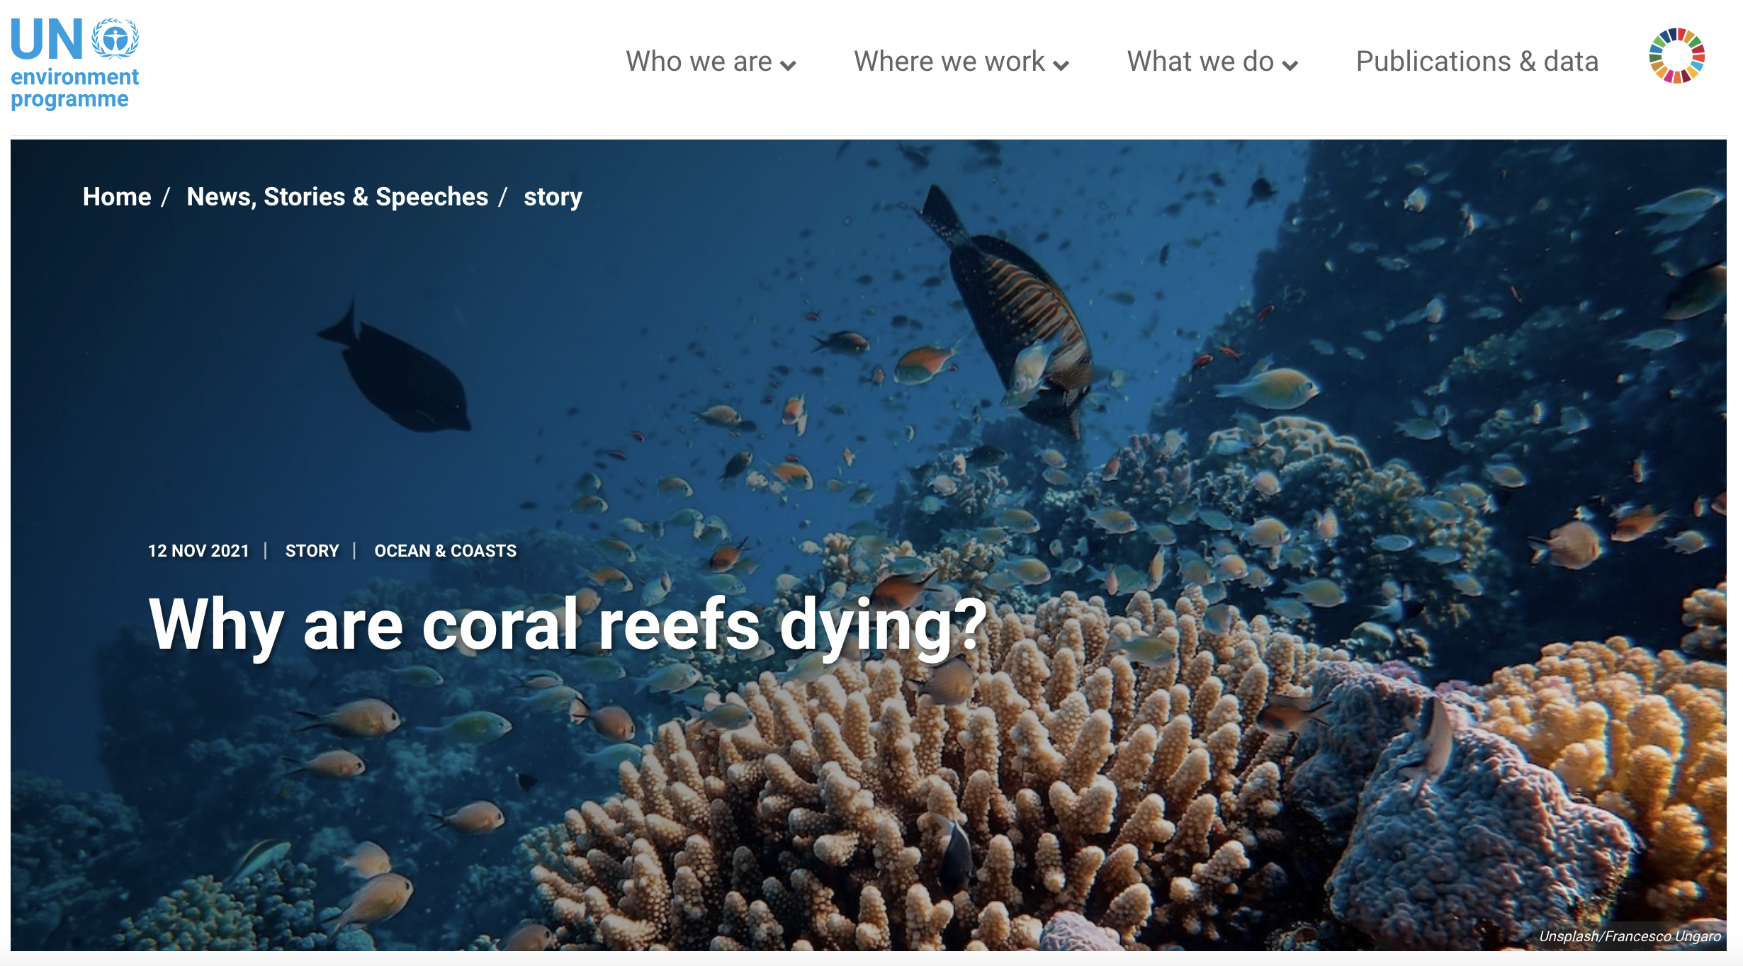
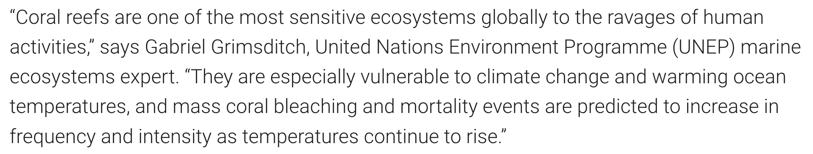
Coral reefs really are dying

Slide 6
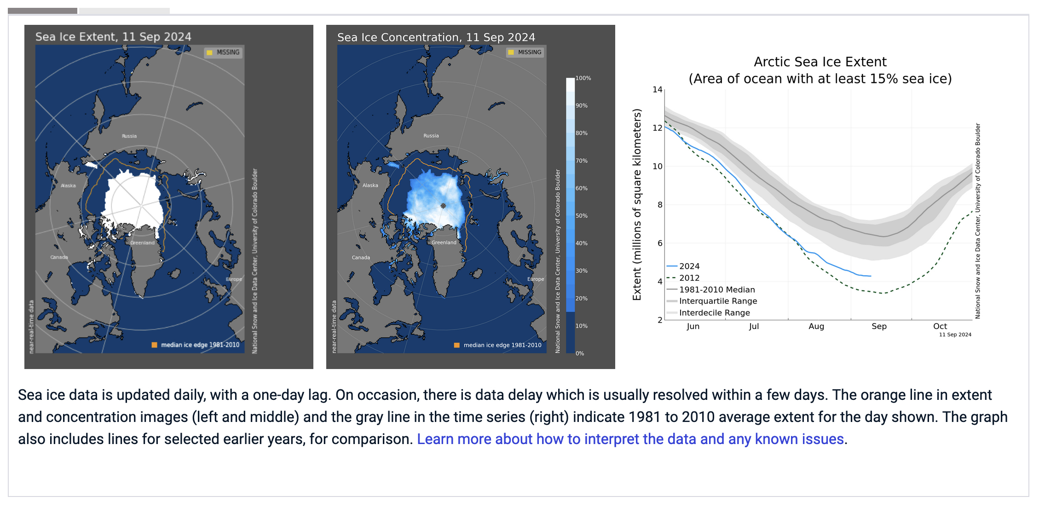
“Polar amplification”: temperature increases (and ocean acidification) are happening much faster there than the rest of the world
(2019)

Slide 7
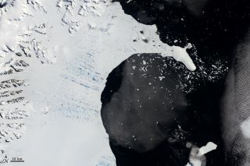
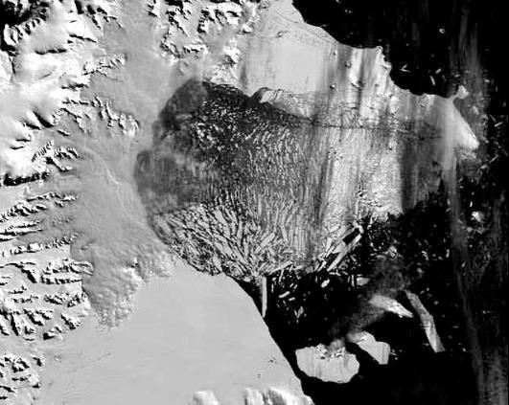
“Polar amplification”: temperature increases (and ocean acidification) are happening much faster there than the rest of the world
January 31, 2002
March 5, 2002
Courtesy of NASA
Photos taken of the Larsen-B ice shelf in the Antarctic Peninsula. Courtesy of NASA
Notes:
Ice in greenland nearly vanishing after a few months

Slide 8
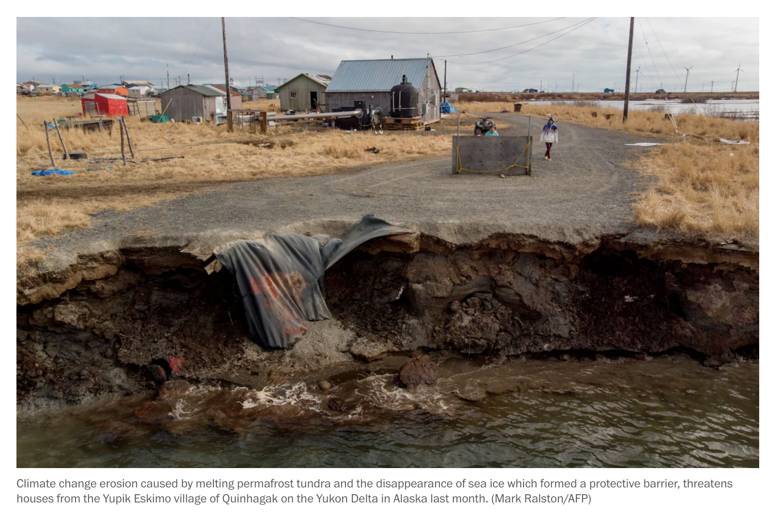
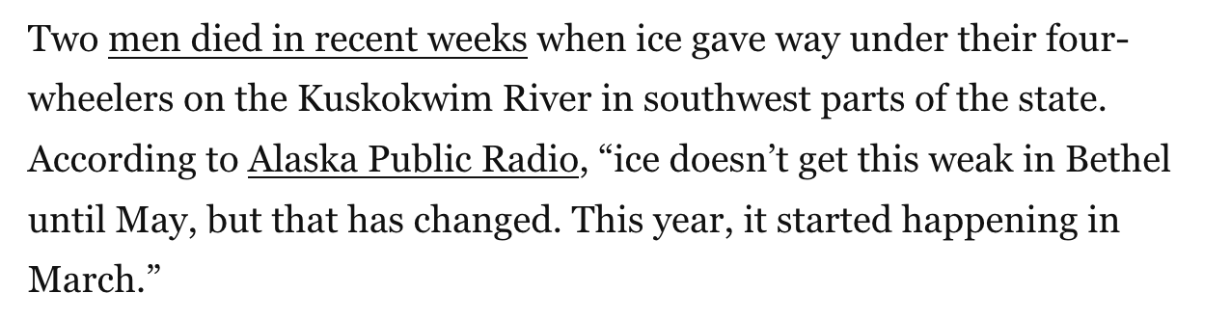
“Polar amplification”: temperature increases (and ocean acidification) are happening much faster there than the rest of the world
(2019)

Slide 9
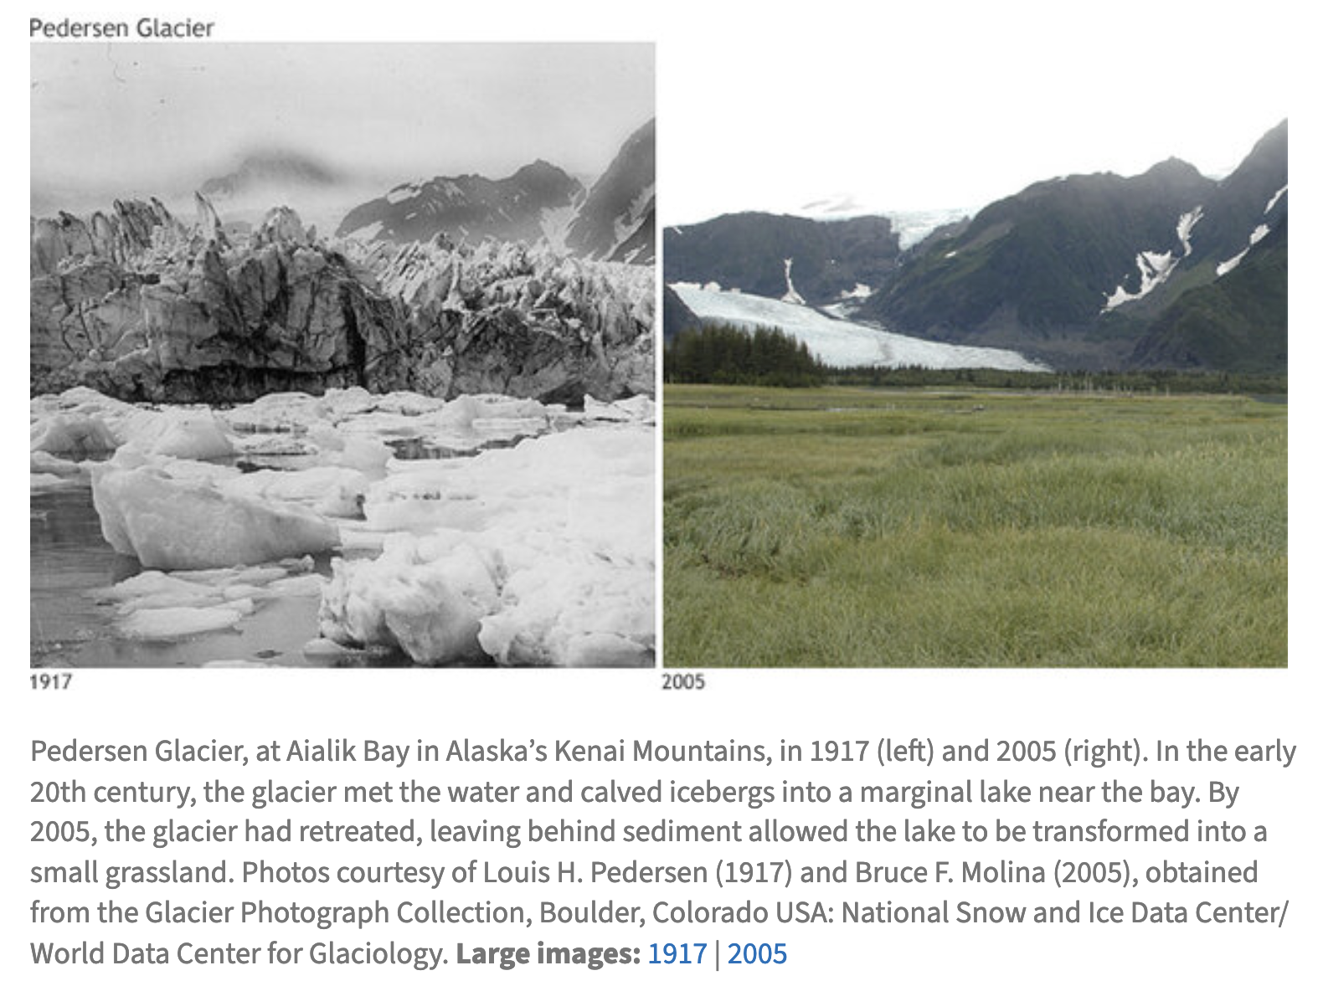
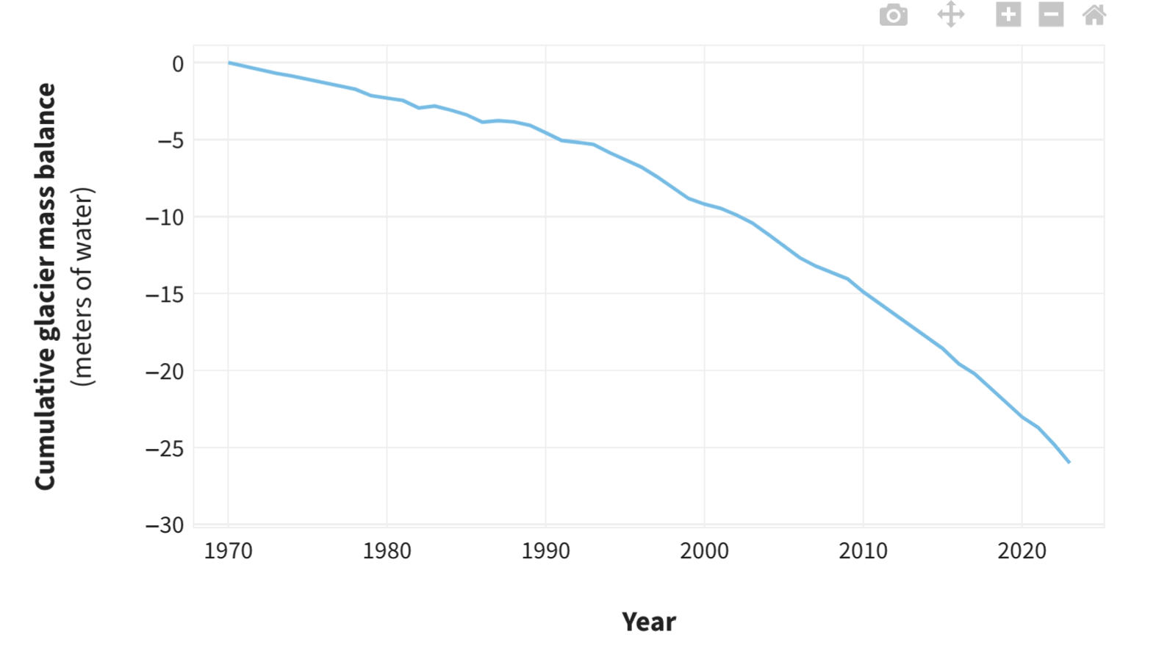
Alpine glaciers (i.e., glaciers on mountains anywhere on the planet) are also in rapid retreat
(2019)

Slide 10
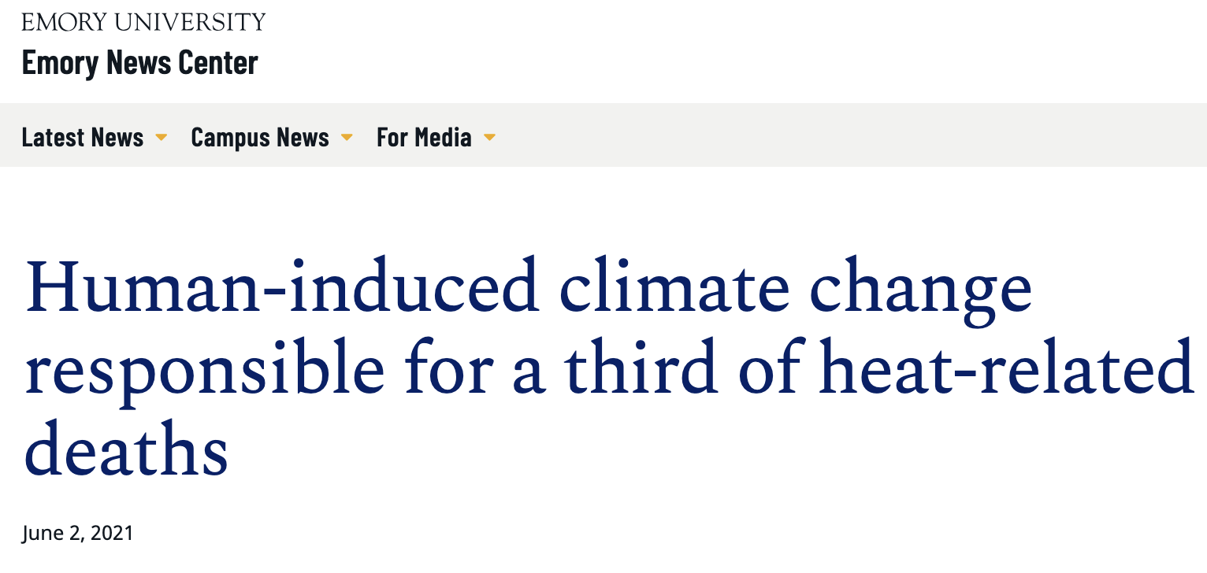
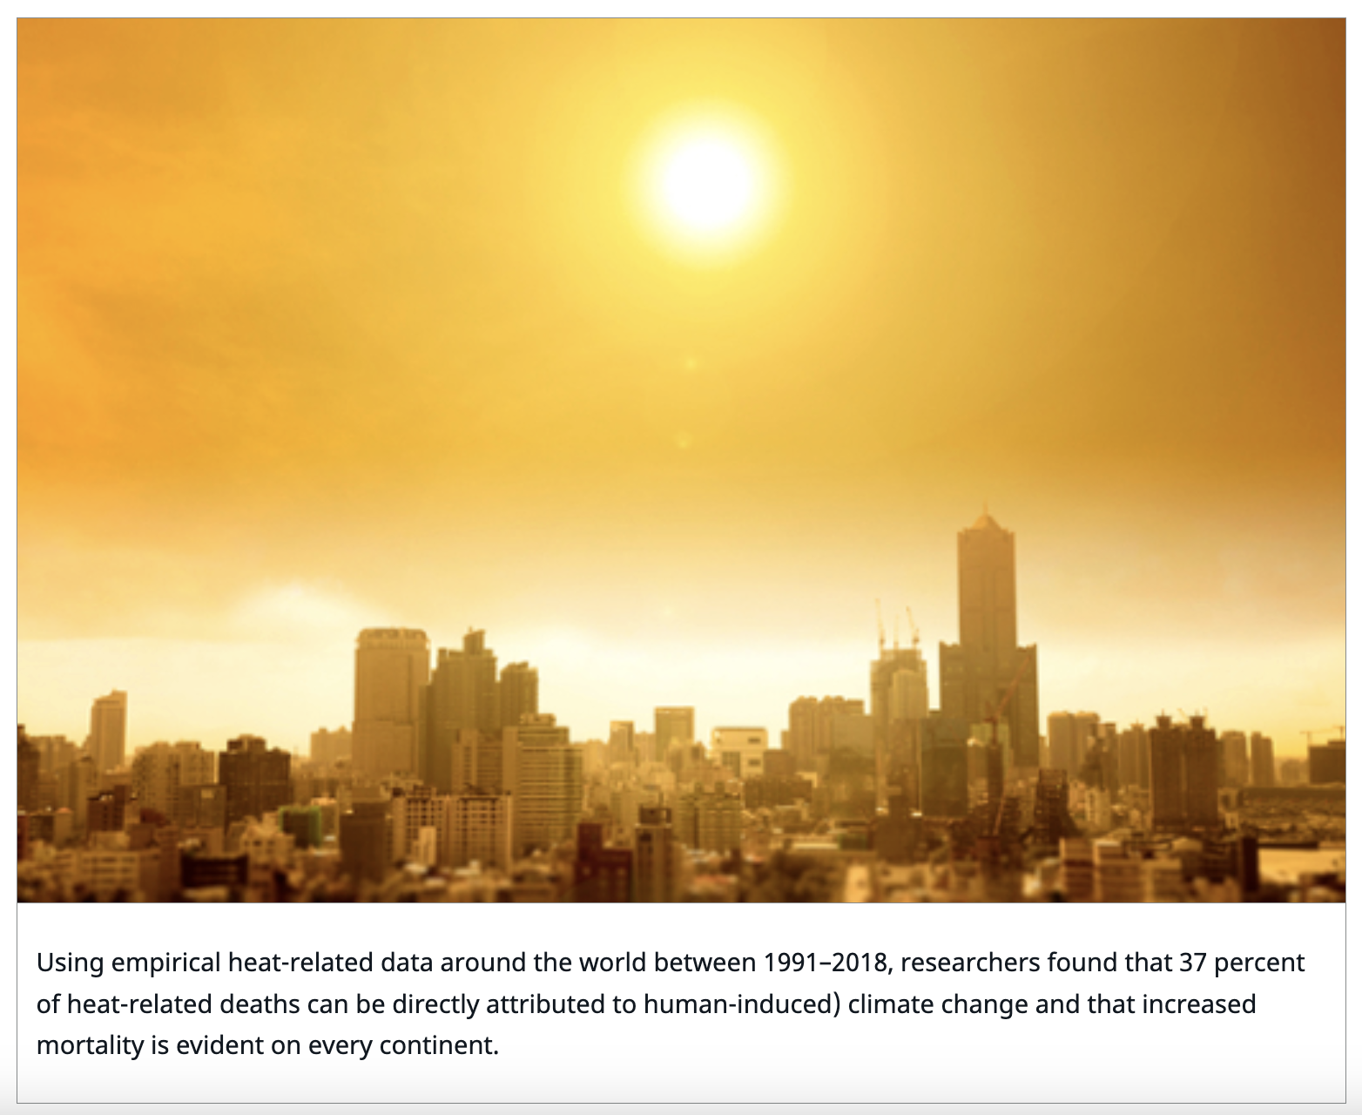
Of the 5 million deaths each year due to temperature extremes, about 1/3 are climate-related
(2019)

Slide 11
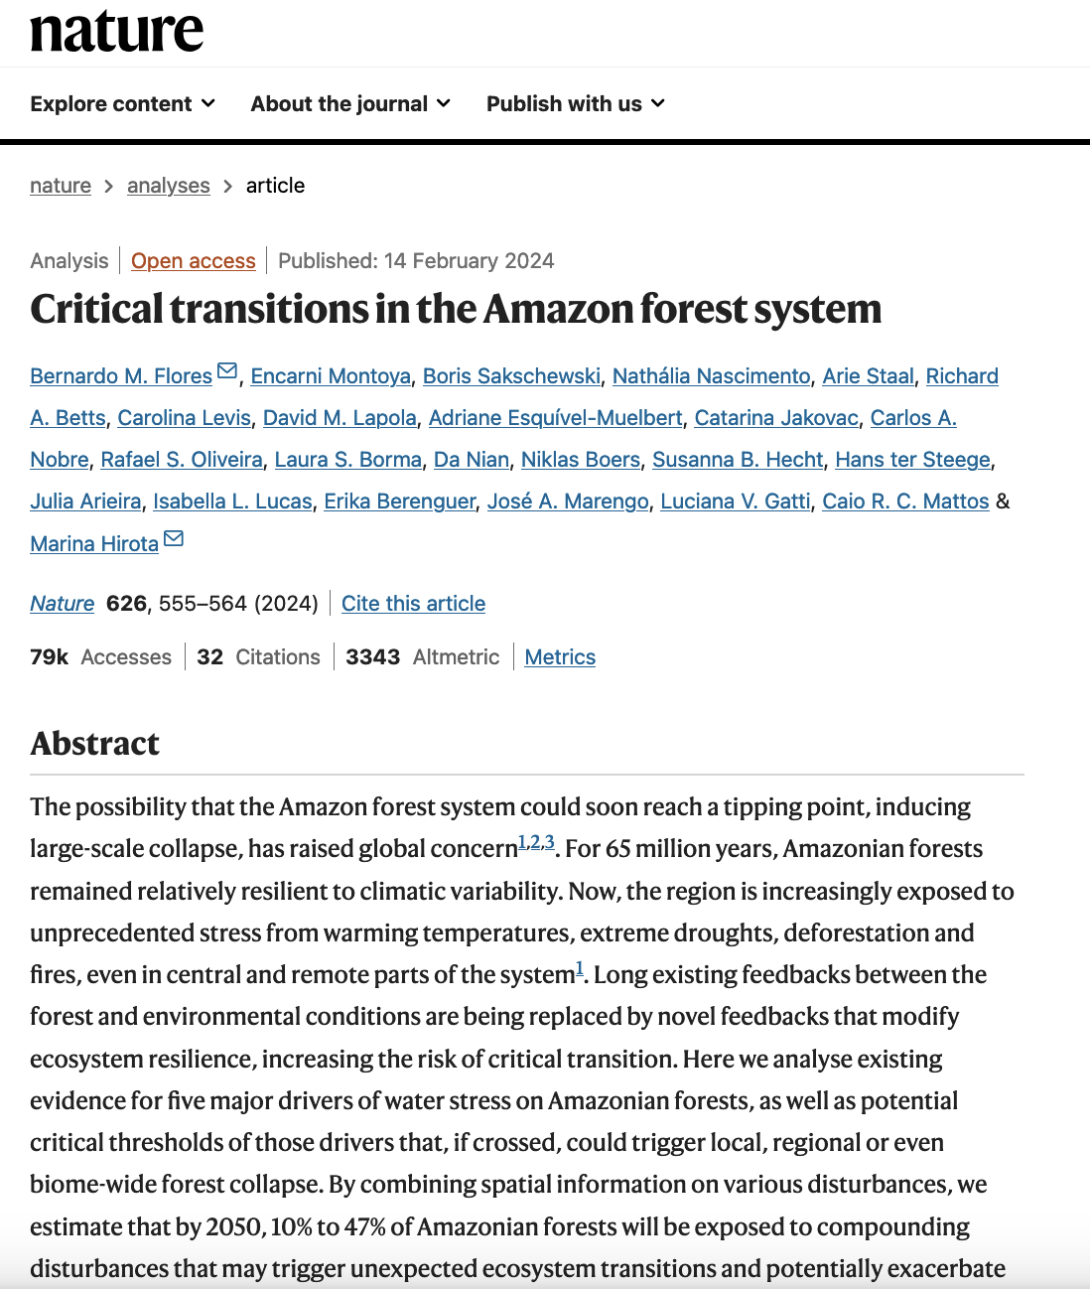
Amazon rainforest vulnerability
(2019)

Slide 12
So yeah, some tipping points been crossed, and we can predict the next elements too

